Slide 1
Analog Game Design
Professor Ira Fay
Class 6

Slide 2
Overview
Weekly gameplay
Playtesting
Destiny (if time allows)

Slide 3
Learn A Name
Learn the name of the person closest to you (whose name you don’t already know)

Slide 4
Slack
In the channel?
Have the app on your phone?

Slide 5
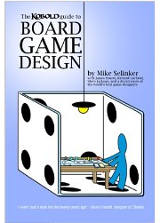
Book
Kobold Guide to Board Game Design
Complete it by February 19

Slide 6
Games with Ira
This Thursday is advising day!

Slide 7
Friday lab
Who went?

Slide 8
Weekly Gameplay Project
Part 1 due today
Small groups
Discuss something new and interesting about the game you played
Notes:
Every Monday, we’ll have a short time devoted to sharing our new games.
Anyone written a session post yet?

Slide 9
Weekly Gameplay Project
Look at session reports
Notes:
Look at example from the assignment

Slide 10
Playtesting
Secret to success in making a great game?

Slide 11
Iteration!
Build
Analyze
Test
No one gets it right on the first try
More iterations lead to a better product
Notes:
Communication and teamwork happening throughout the loop.
Observing and listening happens during the test. Game developers call this phase playtesting.

Slide 12
Who is involved?
Game Designer
Moderator
Playtester

Slide 13
Moderators
Create an environment of open communication

Slide 14
Moderators
Create an environment of open communication
Encourage honesty and criticism

Slide 15
Moderators
Create an environment of open communication
Encourage honesty and criticism
Don’t get defensive

Slide 16
Moderators
Create an environment of open communication
Encourage honesty and criticism
Don’t get defensive
Listen to all the ideas
But you don’t have to do any/all of them!

Slide 17
Moderators
Create an environment of open communication
Encourage honesty and criticism
Don’t get defensive
Listen to all the ideas
Don’t explain your design thinking unless it will help get better feedback
You are there to listen to the player, not the other way around

Slide 18
Answer These Questions

Slide 19
Answer These Questions
What actually happened?
How many players
Who did what
Who won
How long did it take

Slide 20
Answer These Questions
What actually happened?
What confused the players?
What questions did the players ask?

Slide 21
Answer These Questions
What actually happened?
What confused the players?
What questions did the players ask?
Did the players have fun? Why?

Slide 22
Answer These Questions
What actually happened?
What confused the players?
What questions did the players ask?
Did the players have fun? Why?
What could change to increase fun?

Slide 23
Sample Playtest Writeup
To the example!
https://www.dropbox.com/s/0zizjnzcc7ilpln/Ben%20Bailey%20Dice.pdf?dl=0

Slide 24
Collectible Game
Posted on the course website
Part 1 due on Wednesday!
http://swdestinydb.com
Group project!
Final part of SW: Destiny due after Spring Break

Slide 25
Star Wars: Destiny
5-card + 1 die in a Booster pack
$2.99 retail
~$2.25 at bulk discount
~$1.50 for wholesale
Most of the time, a booster pack rapidly loses value as soon as it’s opened
Once in a while the player gets a valuable card

Slide 26
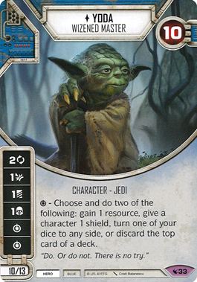
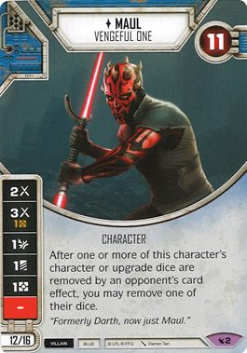
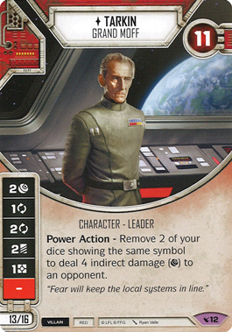
Star Wars: Destiny
“Singles” are individual card sales.
https://www.miniaturemarket.com/searchresults?q=star+wars+destiny
https://www.miniaturemarket.com/searchresults?q=star+wars+destiny#/?_=1&filter.mtg_set=Legacies&page=1&sort.price=desc
Some new cards might be worth $10+

Slide 27
Star Wars: Destiny
Proxies
Easy for commons and uncommons
Cards/Dice are yours to keep
If you don’t want them, I’ll reuse them next semester or donate to library
If anyone gets a Yoda, I’m interested! ;)

Slide 28
Forthcoming
Writing game rules presentation
Playtesting presentation
Master list of due dates
Syllabus has it already!
Games with Ira – more games and dates

